Slide 1
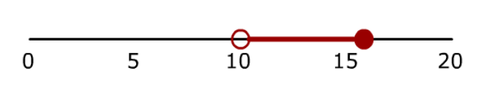
I am thinking of a number and multiplying it by 3 then adding 1.
The answer is less than or equal to 49 and greater than 31.
What numbers could I have chosen?
Form & Solve this inequality
Represent on a number line

Slide 2
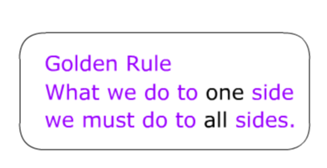
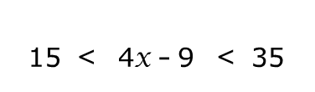

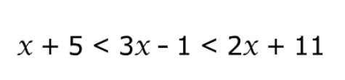
Solve
>>>Challenge

Slide 3
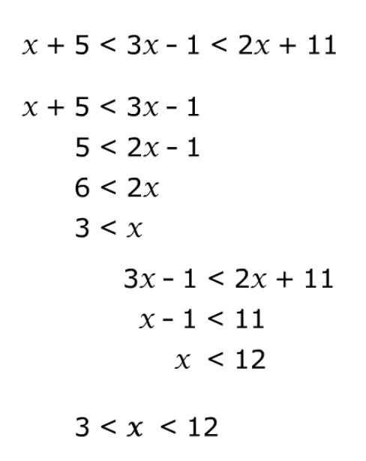
>>>Challenge

Slide 4
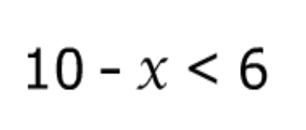
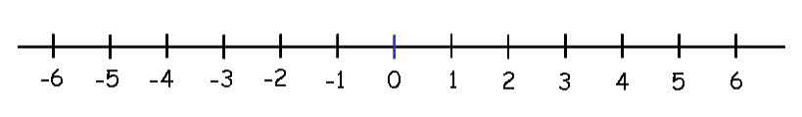
What about this?

Slide 5
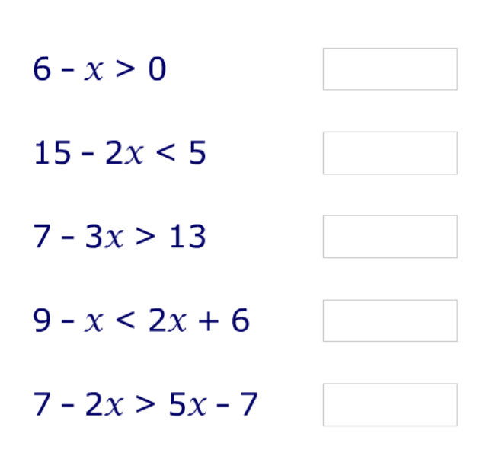
Solve
>>> Extension
Put the x term first in your answer

Slide 6
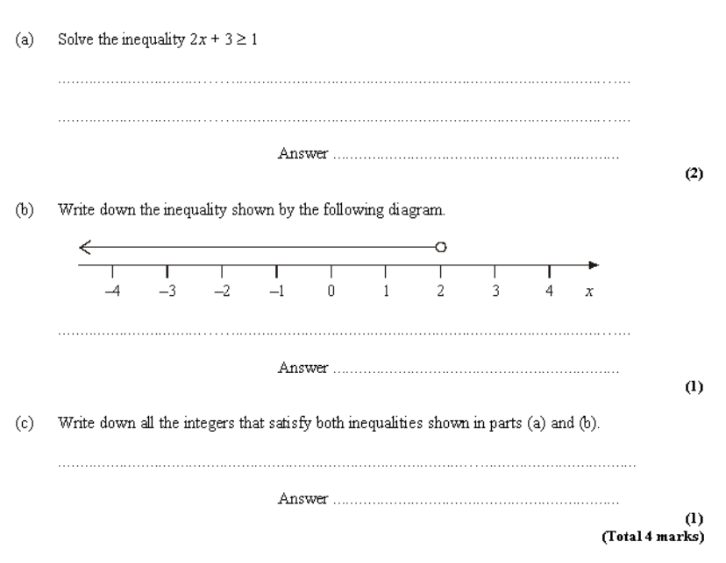
Exam Question

Slide 7
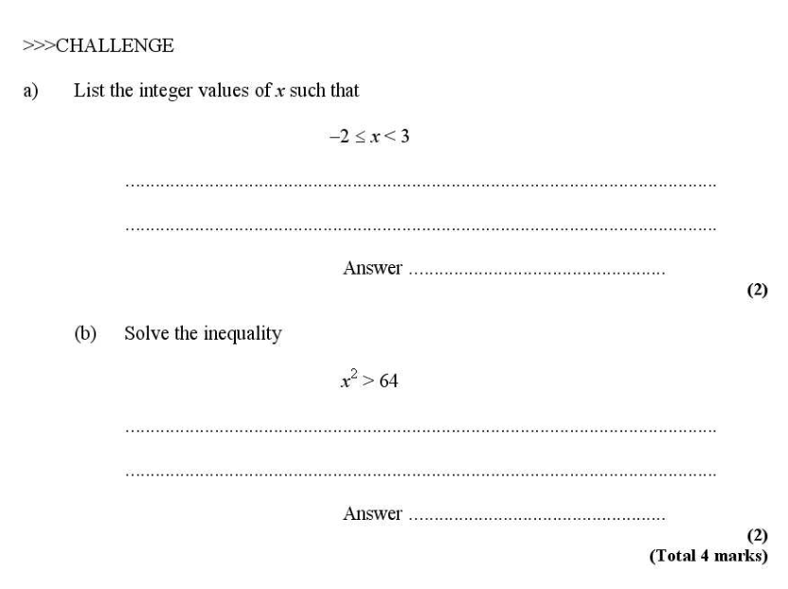

Slide 8
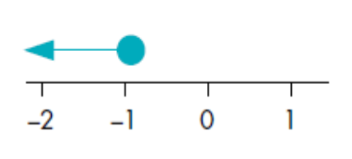
Summary [Grade C]
Write down the linear inequality represented by the following
1)
x ≤ -1

Slide 9
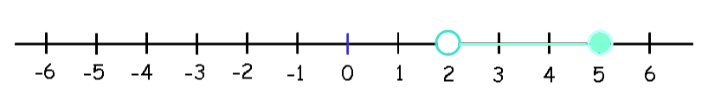
Summary [Grade C]
Write down the linear inequality represented by the following
2)
2 < x ≤ 5

Slide 10
Summary [Grade C]
Solve
3) 3t - 4 > 11
t > 5

Slide 11
Summary [Grade B]
Solve
4) 3y - 12 ≤ y - 4
y ≤ 4

Slide 12
Summary [Grade B]
Solve
5) 7 < 2x + 1 < 13
3 < x < 6

Slide 13
Summary [Grade B]
Solve
6) 11 ≤ 3x + 5 < 17
2 ≤ x < 4

Slide 14
Summary [Grade B]
Solve
7) 7 - 2x > 5x - 7
x < 2

Slide 15
Summary [Grade B]
Solve
8) -3x < -x + 8
x > -4

Slide 16
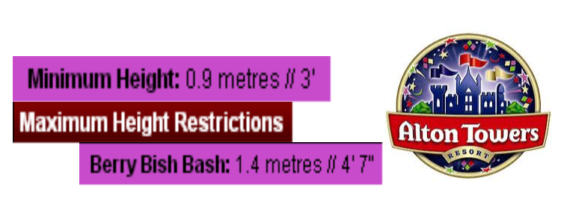
Summary [Grade B]
Form an inequality to represent these height restrictions
9)
0.9 ≤ h ≤ 1.4

Slide 17
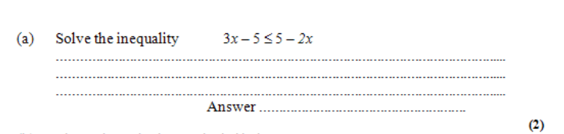
10)

